Slide 1
God calls you to Himself and His Purposes 神呼召你歸向祂和祂的旨意
Jonah 約拿書 1:1-17

Slide 2
他們看起來很友善。也許他們會請我們吃晚餐

Slide 3
Jonah 1:1 The word of the Lord came to Jonah son of Amittai:
1^{ST -} God calls you …to Himself and His Purposes
約拿書 1:1
耶和華的話臨到亞米太的兒子約拿，說:
1.神呼召你歸向祂和祂的旨意

Slide 4
Jonah 1:2 “Go to the great city of Nineveh and preach against it, because its wickedness has come up before me.”
2ND God calls you to save others.
約拿書 1:2
“你起來，往尼尼微大城去，向其中的居民呼喊，因為他們的惡達到我面前。”
2. 神呼召你去拯救他人

Slide 5
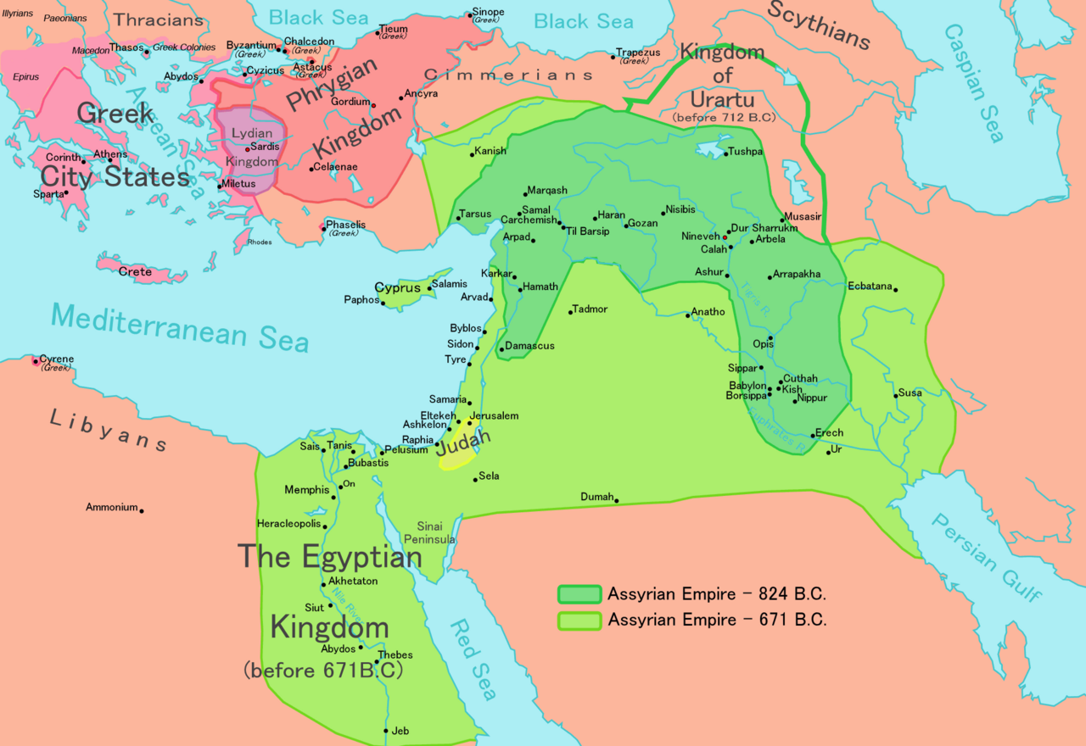

Slide 6
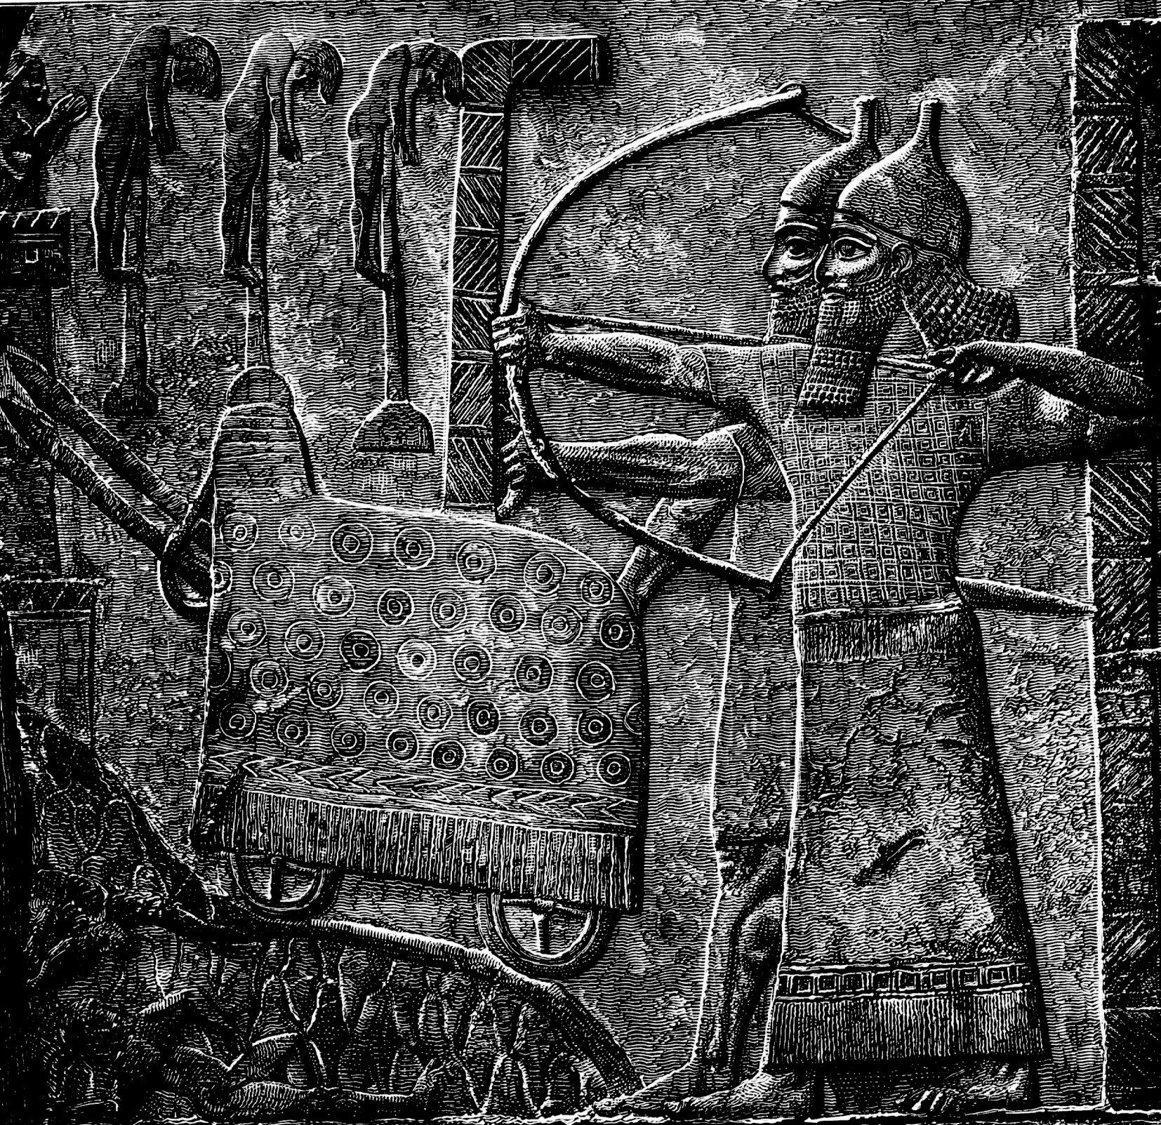

Slide 7
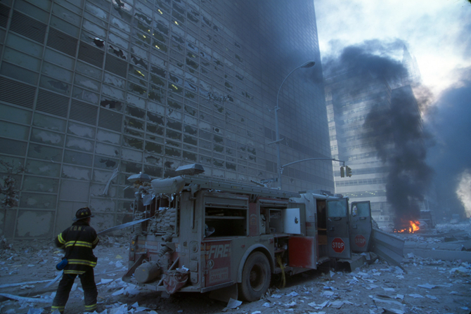
Jonah 1:2 “Go to the great city of Nineveh and preach against it, because its wickedness has come up before me.”
2ND God calls you to save others.
JESUS ENTERS YOUR DARKNESS TO DELIVER YOU… SO YOU CAN ENTER SOMEONE ELSES DARKNESS TO DELIVER THEM.
約拿書 1:2 “你起來，往尼尼微大城去，向其中的居民呼喊，因為他們的惡達到我面前。”
2. 神呼召你去拯救他人
耶穌進入你的黑暗來拯救你……使你也能進入他人的黑暗去拯救他們

Slide 8
Jonah 1:3 But Jonah ran away from the Lord and headed for Tarshish. He went down to Joppa, where he found a ship bound for that port. After paying the fare, he went aboard and sailed for Tarshish to flee from the Lord.
3RD - You run from God’s Call.
約拿書 1:3
約拿卻起來，逃往他施去躲避耶和華的面。他下到約帕，遇見一隻船要往他施去，就給了船價，上了船，要與船上的人同往他施去躲避耶和華。
3. 你逃避神的呼召

Slide 9
Jonah 1:4-16 4 Then the Lord sent a great wind on the sea, and such a violent storm arose that the ship threatened to break up. 5 All the sailors were afraid and each cried out to his own god. And they threw the cargo into the sea to lighten the ship. But Jonah had gone below deck, where he lay down and fell into a deep sleep. 6 The captain went to him and said, “How can you sleep? Get up and call on your god! Maybe he will take notice of us so that we will not perish.” 7 Then the sailors said to each other, “Come, let us cast lots to find out who is responsible for this calamity.” They cast lots and the lot fell on Jonah. 8 So they asked him, “Tell us, who is responsible for making all this trouble for us? What kind of work do you do? Where do you come from? What is your country? From what people are you?”
約拿書 1:4-16
4 耶和華使海中起大風，海就狂風大作，船幾乎破壞。5 水手便懼怕，各人哀求自己的神。他們將船上的貨物拋在海中，為要使船輕些。但約拿已下到底艙，躺臥沉睡。6 船主到他那裡對他說：「你這沉睡的人哪，為何這樣呢？起來，求告你的神；或者神顧念我們，使我們不致滅亡。」7 船上的人彼此說：「來吧，我們掣籤，看看這災臨到我們是因誰的緣故。」於是他們掣籤，掣出約拿來。8 他們對他說：「請你告訴我們，這災臨到我們是因誰的緣故？你以何事為業？你從哪裡來？你是哪一國、屬哪一族的人？」

Slide 10
9 He answered, “I am a Hebrew and I worship the Lord, the God of heaven, who made the sea and the dry land.” 10 This terrified them and they asked, “What have you done?” (They knew he was running away from the Lord, because he had already told them so.) 11 The sea was getting rougher and rougher. So they asked him, “What should we do to you to make the sea calm down for us?” 12 “Pick me up and throw me into the sea,” he replied, “and it will become calm. I know that it is my fault that this great storm has come upon you.” 13 Instead, the men did their best to row back to land. But they could not, for the sea grew even wilder than before. 14 Then they cried out to the Lord, “Please, Lord, do not let us die for taking this man’s life. Do not hold us accountable for killing an innocent man, for you, Lord, have done as you pleased.” 15 Then they took Jonah and threw him overboard, and the raging sea grew calm. 16 At this the men greatly feared the Lord, and they offered a sacrifice to the Lord and made vows to him.
9 他說：「我是希伯來人。我敬畏耶和華─那創造滄海旱地之天上的神。」10 他們就大大懼怕，對他說：「你作的是什麼事呢？」他們已經知道他躲避耶和華，因為他告訴了他們。11 他們問他說：「我們當向你怎樣行，使海浪平靜呢？」這話是因海越發翻騰。12 他對他們說：「你們將我抬起來，拋在海中，海就平靜了。我知道你們遭這大風是因我的緣故。」13 然而那些人竭力盡力搖櫓，要把船拢岸，卻是不能，因為海越發向他們翻騰。14 他們便求告耶和華說：「耶和華啊，我們懇求你，不要因這人的性命使我們死亡；不要使流無辜人的血歸我們，因為你─耶和華是隨自己的意旨行事。」15 他們遂將約拿抬起來，拋在海中，海的狂浪就平息了。16 那些人便大大敬畏耶和華，向耶和華獻祭，並且許願。

Slide 11
Jonah 1:4 Then the Lord sent a great wind on the sea, and such a violent storm arose that the ship threatened to break up.
4TH - God uses circumstances to call you back to Him and His purposes
SOMETIMES GOD WILL NEED TO BREAK UP YOUR SHIP TO CALL YOU BACK TO HIM AND HIS PURPOSES.
約拿書 1:4 耶和華使海中起大風，海就狂風大作，船幾乎破壞。
4. 神利用環境呼召你回到祂和祂的旨意
有時候，神會需要破壞你的船，讓你回到祂和祂的旨意中。

Slide 12
Jonah 1:17 Now the Lord provided a huge fish to swallow Jonah, and Jonah was in the belly of the fish three days and three nights.
5TH - God gives you 2nd chances.
God desires to save you, so you can save others.
約拿書 1:17
耶和華安排一條大魚吞了約拿，約拿在魚的肚子裡三日三夜。
5. 神給你第二次機會。
神渴望拯救你，好讓你能拯救他人

